Slide 1
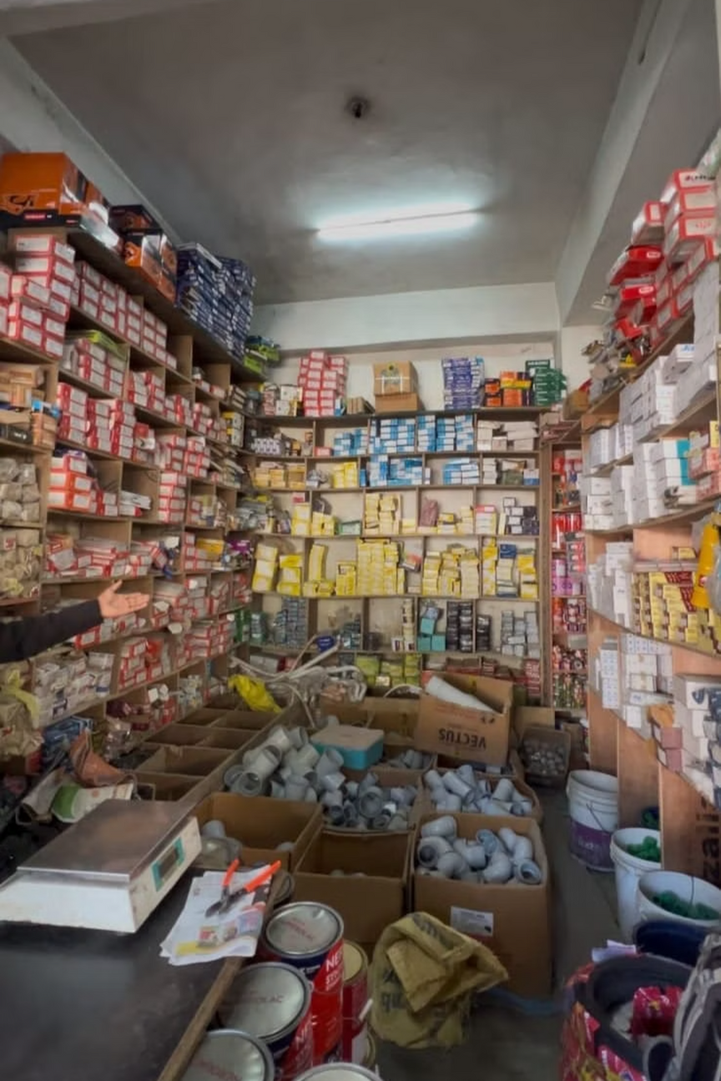

Data-Driven Approach to Reducing Deadstock and Enhancing Sales in The Hardware Shop
Name: Bhawani Dutt
Roll Number: 22F2000273
Affiliation: IITM Online BS Degree Program, IIT Madras, Chennai, India

Slide 2













Organization Background
Thakur Das and Sons was founded on June 15, 2020, by Mr. Pushap Raj in memory of his father. After losing their jobs during the pandemic, he and his two brothers opened the first hardware store in Bagsaid, HP, to meet the town’s limited supply. The business expanded rapidly, and within a short time, three branches were established in Bagsaid, Thunag, and Lambathach, now serving the region’s largest customer base. With a net worth of over ₹1 crore and 15–20 employees across branches, the store has built a strong reputation by offering a wide range of products—from cement, bricks, and interiors to toiletries and hardware tools—while maintaining close ties with its customers.
Thakur Das and Sons
A family-owned hardware store (B2C)
Established
Operating since 2020.
Location
Thunag, Mandi, Himachal Pradesh.
Staff
A dedicated team of 10–15 employees.
Founding
Expansion
Established June 15, 2020 in memory of father
Added branches in Thunag and Lambathach
Key Products
Cement, bricks, saria, tiles, glass, paint, and sanitary items
Revenue
₹2.15 crore in Sept–Nov 2024 (~₹3.90 lakh/day).
First Store
Growth & Impact
Opened hardware store in Bagsaid to meet local needs
₹1 crore net worth and 15–20 employees, broad product range
Thakur Das and Sons
Location
A family-owned hardware store (B2C).
Thunag, Mandi, Himachal Pradesh.
Established
Key Products
Operating since 2020.
Cement, bricks, saria, tiles, glass, paint, and sanitary items.
Staff
Revenue
A dedicated team of 10–15 employees.
₹2.15 crore in Sept–Nov 2024 (~₹3.90 lakh/day).

Slide 3




Problem Statement
Our primary goal is to optimize operations using a data-driven approach, addressing key challenges that impact efficiency and profitability.
Poor Inventory Control
Seasonal Demand Mismatches
Funds Tied in Low-Selling Items
Leads to significant deadstock, tying up capital and reducing available space.
Results in overstocking of certain items due to inaccurate forecasting of seasonal fluctuations.
A lack of clear focus and data insights leads to capital being held in underperforming inventory.

Slide 4
Data Collection & Methodology (Part 1)
1
2
3
Data Sources
Timeframe & Scope
Data Structure
Primary data was meticulously gathered from existing business records, including bills, invoices, and daily sales entries, ensuring direct and reliable information from the source.
The analysis covers a concentrated three-month period from September to November 2024, encompassing 11 distinct product categories and a comprehensive total of 2,847 individual sales entries.
Based on this data, two sheets were created: one for sales and one for inventory.which have a columns like date, item-name, sold quantity, and in invantory is like sold items , stocked left,item category etc
4
Methodological Justification
This approach was chosen to ensure higher accuracy and minimize potential errors often found in raw, unprocessed datasets, forming a robust foundation for our data-driven strategies.

Slide 5






Data Collection & Methodology (Part 2)
Our comprehensive methodology leverages various analytical techniques to transform raw data into actionable insights, driving smarter inventory and sales decisions.
Data Cleaning
Descriptive Statistics
Thorough process to ensure data accuracy, consistency, and completeness, including handling missing values and outlier detection (IQR check).
Trend & Seasonal Analysis
Calculation of mean, coefficient of variation (CV), and distribution analysis to summarize key characteristics of the sales data.
Identification of underlying sales trends and recurring seasonal patterns to inform better forecasting and inventory planning.
Linear Regression
ABC Analysis
Utilized for precise demand forecasting, specifically applied to predict future sales of tile products based on historical data.
Application of the 80/20 rule to categorize inventory items by their value, optimizing stock levels and procurement strategies.
Correlation Analysis
Identification of products frequently purchased together to inform cross-selling strategies and optimize store layout.

Slide 6
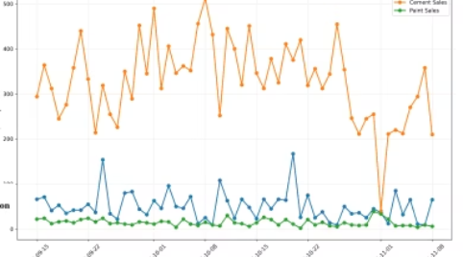

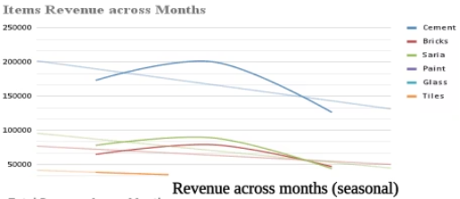
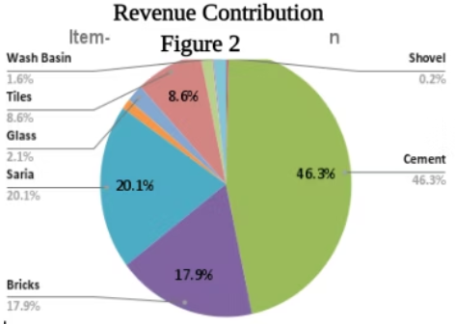
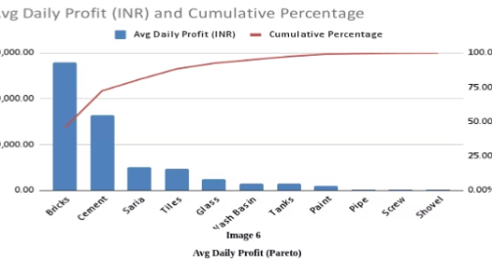
Results & Findings: Sales Performance
Sales Chart
This sales clearly depicts diffrence between tiles 1 cement, 2 tiles , 3 paint.structural material always shows this diffrence to other items
Item
Total Revenue
Avg Daily Rev
Sales Variability 25 %
₹3.90 L
₹2.15 Cr
Gross Profit
Profit Margin
Seasonal Trends
This line chart clearly shows seasonal trend. as revenue approaches winter revenue is decresing
₹33.75 L
15.66%
Bar Revenue
Chart85% structural material dominate chart11 % from wall and interiorelse are very low
80/20
Pareto analysis pareto shows that almost 80 percent of revenue is comming from20 % of items here. some of items are have contibutioin close to 0

Slide 7


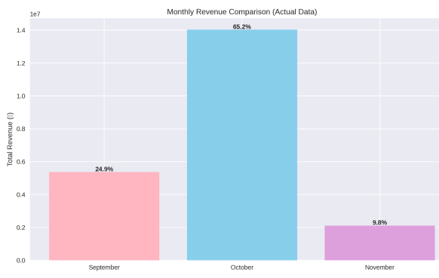
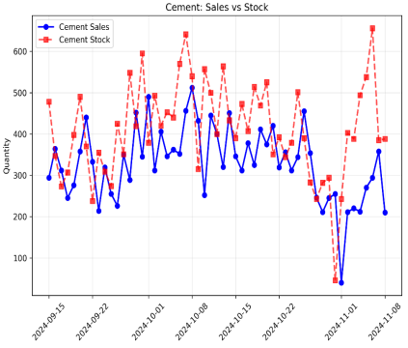
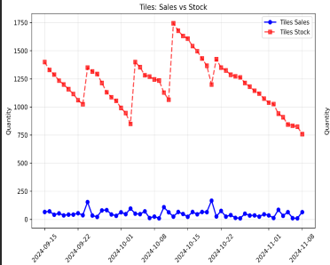
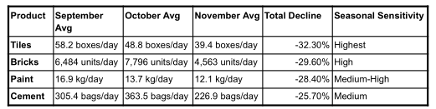
Results & Findings: Inventory Insights
Our analysis reveals critical insights into inventory management, highlighting areas of inefficiency and capital drain.
Tiles Overstocked: 1000% of Sales Rate
Extended Holding Period
A significant overstocking issue was identified for tile.
it shoud be around 500 %
The average holding period for tiles is 25 days, which is considerably higher than the ideal target of 7–10 days.
Deadstock between tiles vs other
Tiles vs Other
diffrence between tiles sold vs stocked with other items sold vs stocked
Seasonal Trend
This Bar Chart shows % decline in
revenue across month.
This Table clearly shows the % decline in items
1st tles, 2nd bricks..

Slide 8



Results & Findings: All Analysis
Our in-depth analysis uncovers key insights into product performance, demand patterns.
Product Correlation
ABC Analysis
High CV Items
Cement and Bricks (r=0.73) are often bought together
Bricks, Cement, and Saria are Category A items, contributing 65% of total revenue
inconsistent sales vs steadier demand.High CV (> 1): Tanks (≈ 1.03), Glass (≈ 0.65)
Indicates bundling opportunities for independent items like Screw, Shovel, and Tanks
Focusing on A-category stock can reduce storage costs by 40% and increase profit by 12%.
Screw(0.71) and Wash Basin (≈ 0.93) vs Low CV (< 0.5): Cement, Bricks, Paint, Tiles
shows 3rd business problem of unrelated items in the shop
Low-Revenue Items
Predictive Modeling for Efficiency
Seasonal Trends
Items like Shovel, Screw, Pipe, and Wash Basin (<2% revenue) can be deprioritized
Tiles deadstock reduced by 70% using linear regression (69.9% accurate), unlocking ₹1.42 lakh in blocked capital.
Significant sales drop of 25-32% in winter
85% revenue decline from October to November
This frees up ₹75K in working capital
It will reduce storage and transportation cost
Adjusting procurement can save ₹2.2 lakh in capital and ₹4.4K/month in storage

Slide 9
Interpretation & Recommendations
Based on our comprehensive data analysis, we've identified critical areas for improvement and developed actionable strategies to optimize performance and profitability.
1
Implement Predictive Stocking
Optimize tile inventory to 375 units, releasing ₹1.42 lakh in blocked capital.
2
Adjust Future Orders
Strategically reduce November orders for Tiles (-35%), Paint (-31%), and Glass (-28%) based on seasonal trends.
3
Prioritize High-Value SKUs
Allocate 70% of inventory focus to Category A products and reduce low-performing SKUs by 40%.
4
Develop Product Bundles
Introduce bundled offers for correlated items like Cement + Bricks to boost sales and increase average transaction value.
5
Track Key Performance Indicators (KPIs)
Regularly monitor metrics such as deadstock percentage and inventory turnover rate to ensure continuous improvement.
6
Strategic Rewards and Promotions to Reduce Tile Deadstock
Run bulk-purchase offers (e.g., “Buy 20 boxes, get 2 free”).
Promote slow-moving tile designs to contractors and builders (who buy in large quantities).
Sell excess tiles through discount outlets or online platforms.

Slide 10

Conclusion & Next Steps
Our data-driven approach promises significant financial benefits and a strategic roadmap for sustained growth and efficiency.
₹2L+
40%
25%
12%
₹3.8L
Capital Freed
Storage Cost Reduction
Inventory Spend Cut
Profit Margin Boost
Annual Savings
Unlock working capital.
Substantial operational savings.
Optimize procurement & stock.
Increase overall profitability.
Significant recurring advantages.
Implement Real-time Inventory
Automate Reorders
Instant stock visibility & control.
AI for accurate forecasting & procurement.
Expand to Future Branches
Shift to Smart Planning
Replicate success across the network.
Data-driven decision-making.
THANK YOU!

